Slide 1
The joint model,
step by step
COMPANION SLIDES · TUTORIAL/MBA_FROM_SCRATCH.IPYNB
How we line up retention times across many GC–MS batches, explained from the linear algebra up, with a refresher wherever one helps.
Every example uses the same small numbers as the notebook, so you can check each one by hand.
Notes:
These slides follow the tutorial notebook section by section. The notebook calls the method MBA; the paper now calls it the joint model, so the slides do too. Each slide's footer names the notebook section it explains.

Slide 2
The same compound comes out at a different time in each batch
1 · THE PROBLEM
Batch A
compound X at bin 50
Batch B
the same compound at bin 56
Compare bin 50 with bin 50 and you compare the compound in A with background in B. Every later statistic is then wrong.
We need a function that says “bin 56 in B is bin 50 in A”, at every time in the run. That function is a warp.
Notebook § 1 · One bin is 0.225 min, so this 6-bin shift is 1.35 min. The shift changes along the run: that is drift.
Notes:
A run is a table of retention-time bins by m/z channels. Between batches the column ages and conditions change, so compounds elute at different times. The shift is not constant: it can grow or shrink along the run, which is why we need a whole function, not one number.

Slide 3


Give every batch one warp into a shared clock
THE BIG IDEA
fₖ
fₗ⁻¹
Batch k’s clock
Shared clock
Batch l’s clock
a time t in batch k
one time axis for everyone
the same compound’s time in batch l
go in
come out
The map from batch k to batch l is g(k→l) = fₗ⁻¹( fₖ(t) ): go into the shared clock, then undo batch l’s warp.
Every route passes through the same clock, so two routes between the same batches can never disagree. Fitting each pair separately has no such guarantee.
Notebook § 2 and § 12 · fₗ⁻¹ is the inverse: the function that undoes fₗ.
Notes:
This is the whole method in one picture. K batches need only K warps, not one per pair. The rest of the deck is about how to describe a warp with a few numbers, and how to choose those numbers from the data.

Slide 4
Vectors, matrices and the one multiplication we need
REFRESHER
Vector
Matrix
Matrix × vector
A list of numbers.
A table of numbers: rows and columns. We will stack one row per equation.
Take each row, multiply it by the vector entry by entry, and add up. One number per row.
v = (0, 2, 1, 3)
Worked example: one row times v
(0, ½, ½, 0) · (0, 2, 1, 3) = 0·0 + ½·2 + ½·1 + 0·3 = 1.5
Notebook § 3 · In NumPy, matrix × vector is written B @ v.
Notes:
Everything in the joint model is built from this one operation. A row of weights times a vector of unknowns gives one number; many rows give many numbers at once. Keep this example in mind: the next slides reuse the same vector (0, 2, 1, 3).

Slide 5
A warp is the identity plus a small drift
2 · A WARP IS JUST A FUNCTION
f(t) = t + d(t)
The drift d is how far the batch’s clock is from the shared clock. No drift means d = 0, and small drifts are small numbers.
Allowed: d(t) = 2 + 0.1t
Not allowed: d(t) = −1.5t
f(10) = 10 + 3 = 13, f(20) = 20 + 4 = 24. The slope is 1.1, so later stays later.
The slope is 1 − 1.5 = −0.5. Time runs backwards, so two compounds would swap order.
The rule we will enforce: the slope stays between 0.5 and 2. No batch runs more than twice as fast, or twice as slow, as the shared clock.
Notebook § 2 · Slope = how much f rises per bin. Positive everywhere = “monotone”: order is preserved.
Notes:
Monotone just means never going down. If compound X elutes before Y in a batch, it must still come first on the shared clock. The 0.5 to 2 range is the paper's Eq. 2.

Slide 6
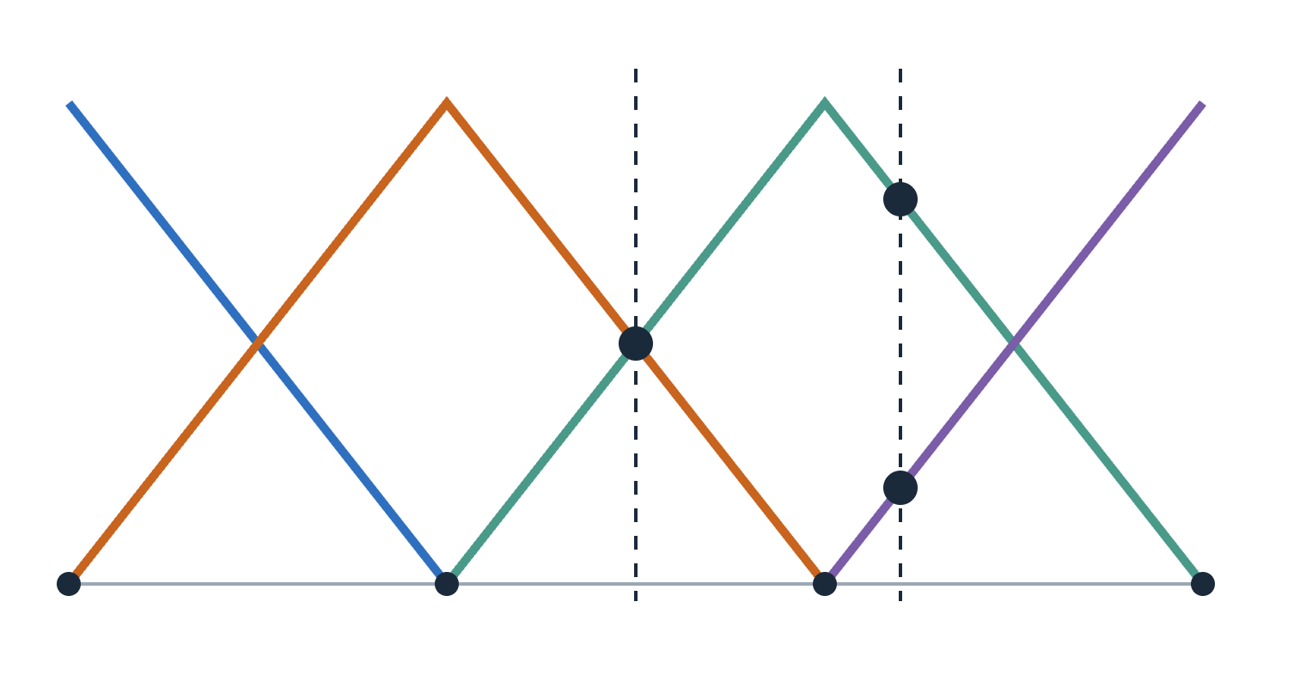
Describe the drift by its values at a few knots
3 · KNOTS AND THE HAT BASIS
Drift at the knots: d = (0, 2, 1, 3). Between knots, join the dots with straight lines.
t = 15 is halfway between knots 1 and 2:
B(15) = (0, ½, ½, 0) → d(15) = 1.5
t = 22 is 2 bins from knot 2 and 8 from knot 3. The nearer knot gets more weight:
Each coloured “hat” is one knot’s weight (height 1 at its own knot). Knots at t = 0, 10, 20, 30; dashed lines at t = 15 and t = 22.
B(22) = (0, 0, 0.8, 0.2) → d(22) = 1.4
Interpolation is a row of weights times the knot values, the multiplication from the refresher. That is what keeps the whole fit linear.
Notebook § 3 · The real model uses 41 knots, about 1.1 min apart. Code: _hat_basis(t, knots).
Notes:
Each knot's weight is 1 minus its distance from t divided by the knot spacing (10 here): at t = 22, knot 2 is 2 away, so 1 − 0.2 = 0.8, and knot 3 is 8 away, so 1 − 0.8 = 0.2. B(t) has at most two non-zero entries, and they always add to 1: the two knots either side of t share the weight, the nearer one getting more. d(22) = 0.8 times 1 plus 0.2 times 3 = 1.4. Stacking B(t) for many times gives a matrix, so evaluating the drift anywhere is one matrix-vector product.

Slide 7
Store the first value and the steps, not every value
4 · PARAMETERISING BY INCREMENTS
Keep c, the drift at the first knot, and the steps δ between neighbouring knots. Adding up the steps gives back every knot value.
L for 4 knots
1 | 0 | 0 | 0
1 | 1 | 0 | 0
1 | 1 | 1 | 0
1 | 1 | 1 | 1
θ = (c, δ₁, δ₂, δ₃) = (0, 2, −1, 2)
running sums → d = (0, 2, 1, 3)
“Running sums” is a matrix too: L, with ones on and below the diagonal. So d = Lθ.
Row 3 · θ = 0 + 2 − 1 + 0 = 1
Why bother? The slope between two knots is 1 + δ / Δu. With knots Δu = 10 apart, “slope between 0.5 and 2” becomes −5 ≤ δ ≤ 10: a limit on one number at a time, which the solver handles easily.
Notebook § 4 · Code: Lcum = np.tril(np.ones((M, M))); bounds lb, ub. c itself has no limit.
Notes:
Check the bound: δ = −5 gives slope 1 − 5/10 = 0.5, and δ = 10 gives 1 + 10/10 = 2. Written on the knot values instead, the same rule would tie each value to its neighbour, which is harder to solve. Same drift, better bookkeeping.

Slide 8
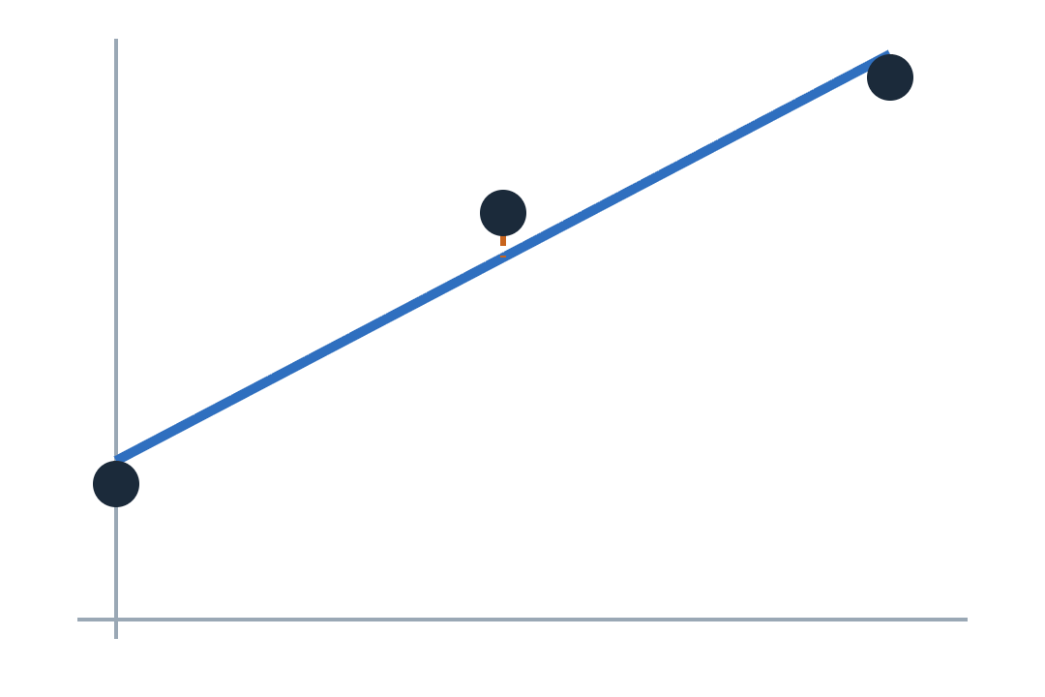
More equations than unknowns? Minimise the squared misses
REFRESHER · 5 · LEAST SQUARES
Model y = m·x + c. One row per point, written Xβ ≈ y:
X = [[0, 1], [1, 1], [2, 1]] β = (m, c) y = (1, 3, 4)
The best β solves the normal equations XᵀXβ = Xᵀy. (Xᵀ, the transpose, swaps rows and columns.)
5m + 3c = 11
3m + 3c = 8 → m = 1.5, c ≈ 1.17
Points (0, 1), (1, 3), (2, 4). No line passes through all three. Orange dashes: the misses we square and add up.
The joint model is this same calculation, with thousands of rows (anchors).
Notebook § 5 · Subtract the two equations: 2m = 3. In NumPy: np.linalg.lstsq(X, y).
Notes:
Each miss is a residual: what the model predicts minus what we saw. Least squares picks the unknowns with the smallest sum of squared residuals. XᵀX is a small square matrix (2 by 2 here); solving it gives the answer in one step. With a fourth point (3, 7) the slope rises to 1.9, as the notebook's exercise shows.

Slide 9
Sometimes there is no single best answer
REFRESHER · 5 · SINGULAR MATRICES
Two columns say the same thing
The test: the determinant
X = [[1, 1], [2, 2]]
XᵀX = [[5, 5], [5, 5]]
For a 2 × 2 matrix [[a, b], [c, d]] it is ad − bc. Here 5·5 − 5·5 = 0.
The model is really y = (m + c)·x. The data pin down the sum m + c, never m and c apart.
Zero means the matrix can’t be inverted (“singular”), so the normal equations have endless solutions.
The joint model hits exactly this problem: the data cannot tell where the shared clock starts. Slide “The gauge” shows the fix.
Notebook § 5 · A direction the data ignore is called the null space: Xv = 0.
Notes:
If m + c must equal 3, then (1, 2), (3, 0) and (−5, 8) all fit the data equally well. Least squares has no reason to prefer one. Fixing that needs extra information that is not in the data, which we add as a penalty.

Slide 10
Each anchor becomes one row of one big equation
6–7 · THE DESIGN MATRIX
An anchor: the same compound, matched by its spectrum, at time a in batch k and b in batch l. Both must land at the same shared time: fₖ(a) = fₗ(b).
Put every batch’s unknowns in one long vector θ, in tiles: one tile of knot values per batch. The anchor only touches the tiles of its own two batches.
Example: 2 batches, knots at 0, 100, 200. An anchor at a = 50 in batch 0 and b = 150 in batch 1.
batch 0’s tile: +B(50)L
batch 1’s tile: −B(150)L
1
0.5
0
−1
−1
−0.5
target y = b − a = 100
Stack one row per anchor into X. The misses are r = Xθ − y: the least-squares problem from the refresher.
Notebook § 6–7 · Each miss is r = a − b + dₖ(a) − dₗ(b) (paper Eq. 3). The fish data give 25,011 rows.
Notes:
Where do the tile numbers come from? B(50) = (0.5, 0.5, 0), then multiplying by L adds from the right: (1, 0.5, 0). B(150) = (0, 0.5, 0.5) becomes (1, 1, 0.5), with a minus sign because batch 1 is on the other side of the equals sign. Row times θ gives d0(50) − d1(150); subtract the target and you get the miss.

Slide 11
The data can’t tell where the shared clock starts
8 · THE GAUGE
Anchor: a = 50 in batch 0, b = 56 in batch 1. The miss is r = a − b + d₀ − d₁.
d₀ = 0, d₁ = −6: 50 − 56 + 0 − (−6) = 0
add 1 to both: 50 − 56 + 1 − (−5) = 0 same miss
Anchors only say where batches sit relative to each other. Shift every drift by the same constant and nothing changes, so XᵀX is singular, exactly as in the refresher. We add one extra rule:
Reference gauge (used in the paper)
Mean gauge
Pin one batch’s drift to 0. The shared clock is then that batch’s own clock: sep2015, the batch with the most anchors.
Make all the drifts add to 0 at every knot. The shared clock is the batches’ average.
Notebook § 8 · Only a constant shift is truly invisible. The two gauges give maps about 0.2 bins apart in the toy, so the paper leaves the choice open.
Notes:
The gauge is added as a very strong penalty rather than an exact rule, so the reference drift is pinned only approximately. Why do the two gauges differ at all? Each drift is smoothed in its own batch's time. Moving the shared clock by anything other than a pure shift changes which warps count as smooth, so the two settle on slightly different answers.

Slide 12
Straight lines are free; every bend costs
9 · THE SMOOTHNESS PENALTY
The second difference of three neighbours x₀, x₁, x₂ is x₀ − 2x₁ + x₂. It measures how much the line bends there.
We add λ × (sum of squared second differences) to the misses. λ sets how much we care about bending.
(0, 2, 1, 3) → (−3, 3) bends
(0, 1, 2, 3) → (0, 0) straight
Trick: a penalty is just extra rows with target 0, so it is still plain least squares.
λ too small
λ about right
λ too large
The drift wiggles to chase noise in the anchors.
Follows the real drift, ignores the noise. Chosen from data (slide “Choosing λ”).
Only a straight line is cheap enough, so real bumps are missed.
Notebook § 9 · λ is scaled by the number of anchors, so one λ means the same smoothness with 600 or 25,000 anchors. Paper Eq. 4.
Notes:
Why extra rows work: a row √λ times D with target 0 has miss √λ times D theta, and squaring it gives λ times (D theta) squared, exactly the penalty. The penalty also settles knots that no anchor touches, such as the very start and end of the run.

Slide 13

Bounds keep every warp running forwards
10 · BOUNDS
Two mismatched anchors can tempt the fit to run a batch’s clock backwards for a stretch. The increments trick turned “slope between 0.5 and 2” into simple limits on each step δ. With knots 9.95 bins apart: −4.98 ≤ δ ≤ 9.95.
Without bounds
With bounds
The fit wants δ = −30.
Slope 1 − 30 / 9.95 ≈ −2.0: time runs backwards.
δ is held at −4.98.
Slope 0.5: slow, but forwards. The other steps adjust around it.
How the solver (BVLS) does it: hold any step that wants to break its limit at the limit, solve ordinary least squares for the rest, and repeat until nothing changes.
Notebook § 10 · Code: lsq_linear(…, bounds=(lb, ub), method='bvls'). The real code goes via a Cholesky factor; same answer.
Notes:
BVLS stands for bounded-variable least squares. The real fit_joint first forms the normal matrix and its Cholesky factor, then calls the same bounded solver. Both routes minimise the same quantity, and the notebook checks they agree to about 10 to the minus 13 bins.

Slide 14
Listen less to anchors that are far off
11 · ROBUST REWEIGHTING
Some anchors are wrong: two different compounds with similar spectra. One anchor 30 bins off adds 30² = 900 to the sum of squares and drags the fit.
Miss | Huber weight | Tukey weight
1 | 1.00 | 0.96
2 | 1.00 | 0.84
3 | 0.66 | 0.66
4 | 0.50 | 0.45
100 (wrong) | 0.02 | 0
A typical miss size that outliers can’t inflate. Misses (1, 2, 3, 4, 100): the median is 3, distances from it are (2, 1, 0, 1, 97), their median is 1. Scale σ̂ = 1.4826 × 1 ≈ 1.48. (The standard deviation would be 39.)
Then repeat: fit → misses → σ̂ → weights → fit again.
Huber (3 rounds) shrinks big misses but never to zero. Tukey (4 rounds) drops gross ones entirely.
Notebook § 11 · Huber: weight 1 up to 1.345σ̂, then shrinking. Tukey: (1 − (r/c)²)² up to c = 4.685σ̂, else 0. Code: _robust_sigma, fit_joint.
Notes:
This is iteratively reweighted least squares, or IRLS. Huber goes first because it gives a stable starting fit; Tukey then removes what is clearly wrong. Note that Tukey also trims good misses of 3 and 4 a little: only misses near zero keep a weight near 1. In the real code, 7 reweighting rounds are followed by one final solve. On the fish data 3.9 percent of anchors end with weight 0.

Slide 15
Every route through the shared clock gives the same answer
12 · MAPS BETWEEN BATCHES
Three toy warps: fₖ(t) = t + 2, fₗ(t) = t − 3, fₘ(t) = 2t. Their inverses undo them: fₗ⁻¹ adds 3 back, fₘ⁻¹ halves.
Direct k → l
10 ─fₖ→ 12 ─fₗ⁻¹→ 15
Via m
10 ─fₖ→ 12 ─fₘ⁻¹→ 6 ─fₘ→ 12 ─fₗ⁻¹→ 15
Both routes pass through 12 on the shared clock, so they must agree. This is called transitivity, and the joint model has it by construction.
Fit each pair separately and the three maps around a triangle come from three unrelated fits. On the fish data they disagree by 0.116 min on average (paper result).
Notebook § 12 · In code, f⁻¹ is found by evaluating f on a fine grid and swapping the axes with np.interp. JointWarp.map(k, l, t).
Notes:
The inverse of a function undoes it: if f adds 2, its inverse subtracts 2. A monotone warp always has an inverse, which is one more reason the bounds matter. Near the ends of the run the computed inverse holds the end value, so maps clamp there.

Slide 16
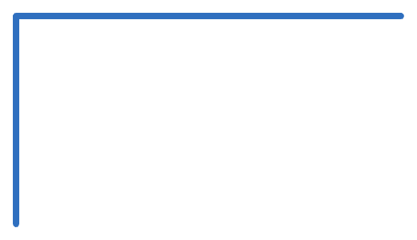
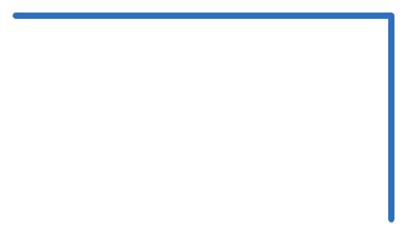
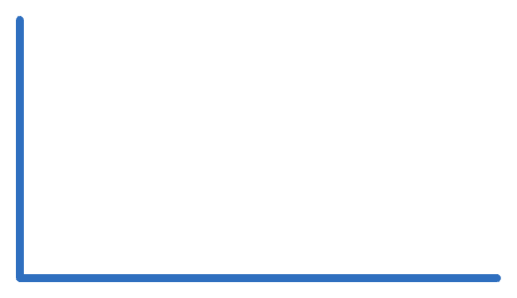
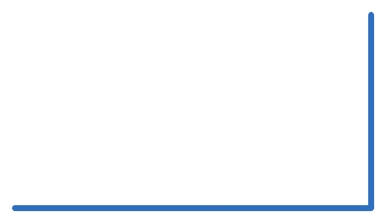
A batch with few anchors is aligned through the others
13 · BORROWING STRENGTH
B → A: −9
B
D → B: +3
If D → B is a shift of +3 and B → A is −9, then D → A is −6, even with no D–A anchor at all.
A
few direct D–A anchors
D
The joint fit uses every path at once: D → B → A and D → C → A. In the toy, batch D has only 2 samples.
The catch: with plenty of good direct anchors, a fit dedicated to one pair can follow it a little more closely.
C
Notebook § 13 · With all 74 direct D–A anchors, the pairwise fit is slightly better (about 0.4 vs 0.5 bins).
Notes:
This is the same trade-off the paper reports on the fish data: the joint model gains most on pairs with few samples, such as those involving the two-sample aug2015 batch, while dense interpolation wins two pairs with thousands of direct anchors.

Slide 17
Anchors are found by matching spectra, for every pair of samples
14 · WHERE ANCHORS COME FROM
Peaks: the tallest points of each total ion chromatogram (at most 30).
Fingerprint: the mass spectrum around each peak, scaled to length 1.
Compare every peak in sample A with every peak in sample B by cosine similarity.
Pair them up one-to-one with the best total similarity (Hungarian algorithm).
Clean up: drop weak matches, refine to fractions of a bin, drop matches far off a robust line (RANSAC), keep only pairs in increasing order.
Refresher: cosine similarity
For length-1 vectors, the dot product is the cosine: 1 = identical spectra, 0 = nothing shared.
(1,0,1)/√2 · (1,1,0)/√2 = ½
Why not just greedy?
Similarities [[0.9, 0.8], [0.85, 0.1]]. Greedy takes 0.9, then is stuck with 0.1: total 1.0. Best pairing: 0.8 + 0.85 = 1.65.
Notebook § 14 · Peaks more than 20 min apart are never paired. Code: match_anchors, harvest_anchors. The fish data give 25,011 anchors.
Notes:
Up to this point the notebook uses perfect anchors from the true compound positions, so the maths can be checked against the truth. Real anchors are noisier: a neighbouring compound shifts a peak top slightly, and the fingerprint averages three bins. A few are outright mismatches, which is what robust reweighting is for.

Slide 18
Hide whole stretches of time, then try to predict them
15 · CHOOSING Λ
Cross-validation: hide part of the anchors, fit on the rest, score how well the fit predicts the hidden ones. Try each λ; keep the best score. The truth and the evaluation metric are never used.
Why hide time, not samples? Hidden samples leave anchors at the same compounds’ times as the training anchors, so a wiggly drift that passes through every compound still looks perfect.
Retention time cut into blocks of 12 bins; block b goes to fold b mod 5:
0
1
2
3
4
0
1
2
3
4
Bins 0–11, 12–23, …, 108–119: the first ten blocks, labelled with their fold.
Example: t = 30 is in block 2 → fold 2; t = 70 is in block 5 → fold 0. The anchor (30, 70) is hidden in both folds 2 and 0. On the fish data this chose λ = 10.
Notebook § 15 · An anchor trains a fold only if neither of its times is in that fold. Score: median |prediction error|. Code: scripts/30_multibatch_align.py.
Notes:
Block b is the block covering bins 12b to 12b plus 11, so t = 30 sits in block 2 and t = 70 in block 5; 5 mod 5 is 0. Hiding whole windows measures how well the fit interpolates across gaps between compounds, which is exactly where a too-wiggly drift goes wrong. The notebook shows sample folds barely penalise the smallest λ, while blocked folds penalise it clearly.

Slide 19
Refit on resampled data to see how much the warps move
16 · BOOTSTRAP UNCERTAINTY
1. Resample
2. Reweight, refit
3. Read off a band
Within each batch, draw samples with replacement. Counts (2, 0, 1): sample 0 twice, sample 1 never, sample 2 once.
An anchor’s weight = the product of its two samples’ counts: 2 × 1 = 2. Refit, and repeat 200 times.
The 5th–95th percentile of the refitted maps at each time: a 90% band. Add anchor scatter for a predictive interval.
Honest result: the intervals are too narrow. On the fish data the 90% predictive intervals contain 81% of held-out anchors (paper result).
Why: a bootstrap sees how much a fit varies, not a bias every refit shares. The smoothness penalty pulls every refit towards a straighter drift the same way, so the band sits in slightly the wrong place.
Notebook § 16 · Predictive half-width = √(half-band² + (1.645 σ)²), σ the pair’s robust scale. Calibration (e.g. conformal) is the suggested fix.
Notes:
Weighting anchors by sample counts is the same as copying samples, but cheaper: no anchors need re-harvesting. 1.645 is the point that leaves 5 percent in each tail of a normal distribution, which is what makes a 90 percent interval. The notebook's exercise refits with less smoothing so you can test the bias explanation yourself.

Slide 20
One least-squares problem, with four additions
THE WHOLE RECIPE
minimise Σ wⱼ rⱼ² + λ′ · bending + γ · gauge
keeping every slope between 0.5 and 2
rⱼ
wⱼ
bending
gauge
slope limits
one miss per anchor, linear in θ
robust weights, updated each round
squared second differences; λ by blocked CV
pins where the shared clock sits
box bounds on each step δ
§ 3–7
§ 11
§ 8
§ 4, 10
§ 9, 15
Then every map between batches is g(k→l) = fₗ⁻¹ ∘ fₖ (§ 12), consistent by construction, with a bootstrap band (§ 16).
Section numbers refer to tutorial/mba_from_scratch.ipynb. § 18 checks the from-scratch version against src/multibatch.py.
Notes:
Read the formula left to right: fit the anchors, weighting out the bad ones; prefer straight drifts; fix where the shared clock sits; never let a clock run backwards. Everything else in the notebook is how to build each piece and how to check it. The CODE_MAP file links each symbol here to its line in the code.

